Slide 1
William Stallings
Computer Organization and Architecture
7th Edition
Chapter 5
Internal Memory

Slide 2
Big Picture Motivation
Processor can compute only as fast as memory
  A 3Ghz processor can execute an “add” operation in 0.33ns
  Today’s “Main memory” latency is more than 33ns
  Naïve implementation: loads/stores can be 100x slower than other operations
Unobtainable goal:
  Memory that operates at processor speeds
  Memory as large as needed for all running programs
  Memory that is cost effective
Can’t achieve all of these goals at once
  Example: latency of an SRAM is at least: sqrt(number of bits)

Slide 3
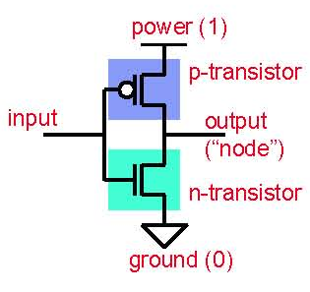
Complementary MOS (CMOS)
Voltages as values
  Power (VDD) = “1”, Ground = “0”
Two kinds of MOSFETs
  N-transistors
    Conduct when gate voltage is 1
    Good at passing 0s
  P-transistors
    Conduct when gate voltage is 0
    Good at passing 1s
CMOS
  Complementary n-/p- networks form boolean logic (i.e., gates)
  And some non-gate elements too (important example: RAMs)

Slide 4
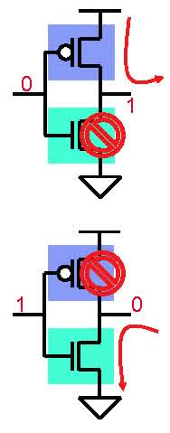
Basic CMOS Logic Gate
Inverter: NOT gate
  One p-transistor, one n-transistor
  Basic operation
  Input = 0
    P-transistor closed, n-transistor open
    Power charges output (1)
  Input = 1
    P-transistor open, n-transistor closed
    Output discharges to ground (0)

Slide 5
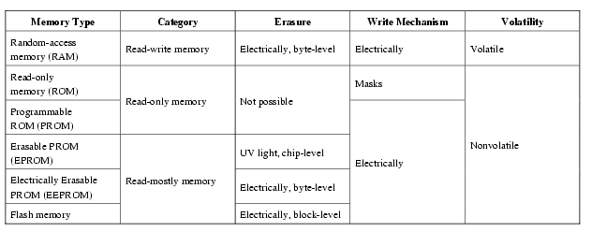
Semiconductor Memory Types

Slide 6
Types of Memory
Static RAM (SRAM)
  6 or 8 transistors per bit
    Two inverters (4 transistors) + transistors for reading/writing
  Optimized for speed (first) and density (second)
  Fast (sub-nanosecond latencies for small SRAM)
    Speed roughly proportional to its area
  Mixes well with standard processor logic
Dynamic RAM (DRAM)
  1 transistor + 1 capacitor per bit
  Optimized for density (in terms of cost per bit)
  Slow (>40ns internal access, ~100ns pin-to-pin)
  Different fabrication steps (does not mix well with logic)
Nonvolatile storage: Magnetic disk, Flash RAM

Slide 7
Semiconductor Memory
RAM
  Misnamed as all semiconductor memory is random access
  Read/Write
  Volatile
  Temporary storage
  Static or dynamic

Slide 8
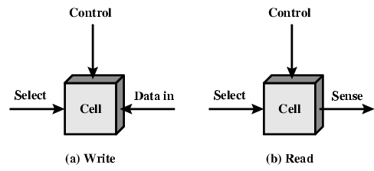
Memory Cell Operation

Slide 9
Dynamic RAM
Bits stored as charge in capacitors
Charges leak
Need refreshing even when powered
Simpler construction
Smaller per bit
Less expensive
Need refresh circuits
Slower
Main memory
Essentially analogue
  Level of charge determines value

Slide 10
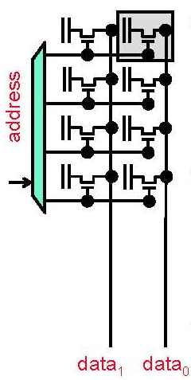
DRAM Circuit Implementation
DRAM: dynamic RAM
  Bits as capacitors
  Transistors as ports
  “1T” cells: one access transistor per bit
“Dynamic” means
  Capacitors not connected to power/ground
  Stored charge decays over time
  Must be explicitly refreshed
Designed for density
  ~6–8X denser than SRAM
  But slower too

Slide 11
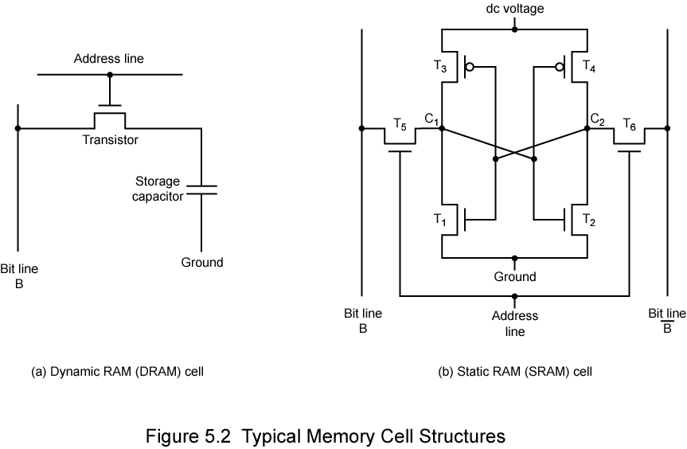
Dynamic RAM Structure

Slide 12
DRAM Operation
Address line active when bit read or written
  Transistor switch closed (current flows)
Write
  Voltage to bit line
    High for 1 low for 0
  Then signal address line
    Transfers charge to capacitor
Read
  Address line selected
    transistor turns on
  Charge from capacitor fed via bit line to sense amplifier
    Compares with reference value to determine 0 or 1
  Capacitor charge must be restored

Slide 13
Static RAM
Bits stored as on/off switches
No charges to leak
No refreshing needed when powered
More complex construction
Larger per bit
More expensive
Does not need refresh circuits
Faster
Cache
Digital
  Uses flip-flops

Slide 14
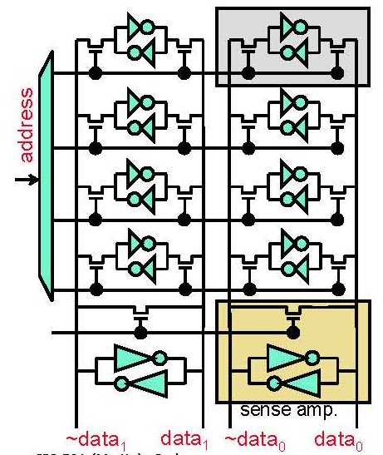
SRAM Circuit Implementation
SRAM:
  Six transistors (6T) cells
    4 for the cross-coupled inverters
    2 access transistors
“Static”
  Cross-coupled inverters hold state
To read
  Equalize (pre-charge to 0.5), swing, amplify
To write
  Overwhelm

Slide 15
Static RAM Structure

Slide 16
Static RAM Operation
Transistor arrangement gives stable logic state
State 1
  C₁ high, C₂ low
  T₁ T₄ off, T₂ T₃ on
State 0
  C₂ high, C₁ low
  T₂ T₃ off, T₁ T₄ on
Address line transistors T₅ T₆ is switch
Write – apply value to B & compliment to B
Read – value is on line B

Slide 17
SRAM v DRAM
Both volatile
  Power needed to preserve data
Dynamic cell
  Simpler to build, smaller
  More dense
  Less expensive
  Needs refresh
  Larger memory units
Static
  Faster
  Cache

Slide 18
Read Only Memory (ROM)
Permanent storage
  Nonvolatile
Microprogramming (see later)
Library subroutines
Systems programs (BIOS)
Function tables

Slide 19
Types of ROM
Written during manufacture
  Very expensive for small runs
Programmable (once)
  PROM
  Needs special equipment to program
Read “mostly”
  Erasable Programmable (EPROM)
    Erased by UV
  Electrically Erasable (EEPROM)
    Takes much longer to write than read
  Flash memory
    Erase whole memory electrically

Slide 20
Organisation in detail
A 16Mbit chip can be organised as 1M of 16 bit words
A bit per chip system has 16 lots of 1Mbit chip with bit 1 of each word in chip 1 and so on
A 16Mbit chip can be organised as a 2048 x 2048 x 4bit array
  Reduces number of address pins
    Multiplex row address and column address
    11 pins to address (2¹¹=2048)
    Adding one more pin doubles range of values so x4 capacity

Slide 21
Refreshing
Refresh circuit included on chip
Disable chip
Count through rows
Read & Write back
Takes time
Slows down apparent performance

Slide 22
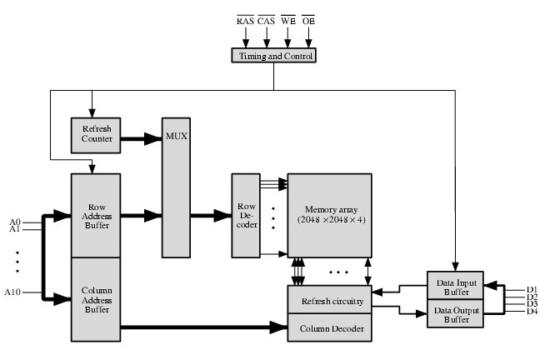
Typical 16 Mb DRAM (4M x 4)

Slide 23
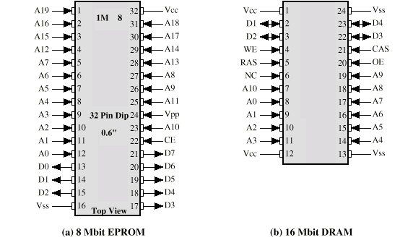
Packaging

Slide 24
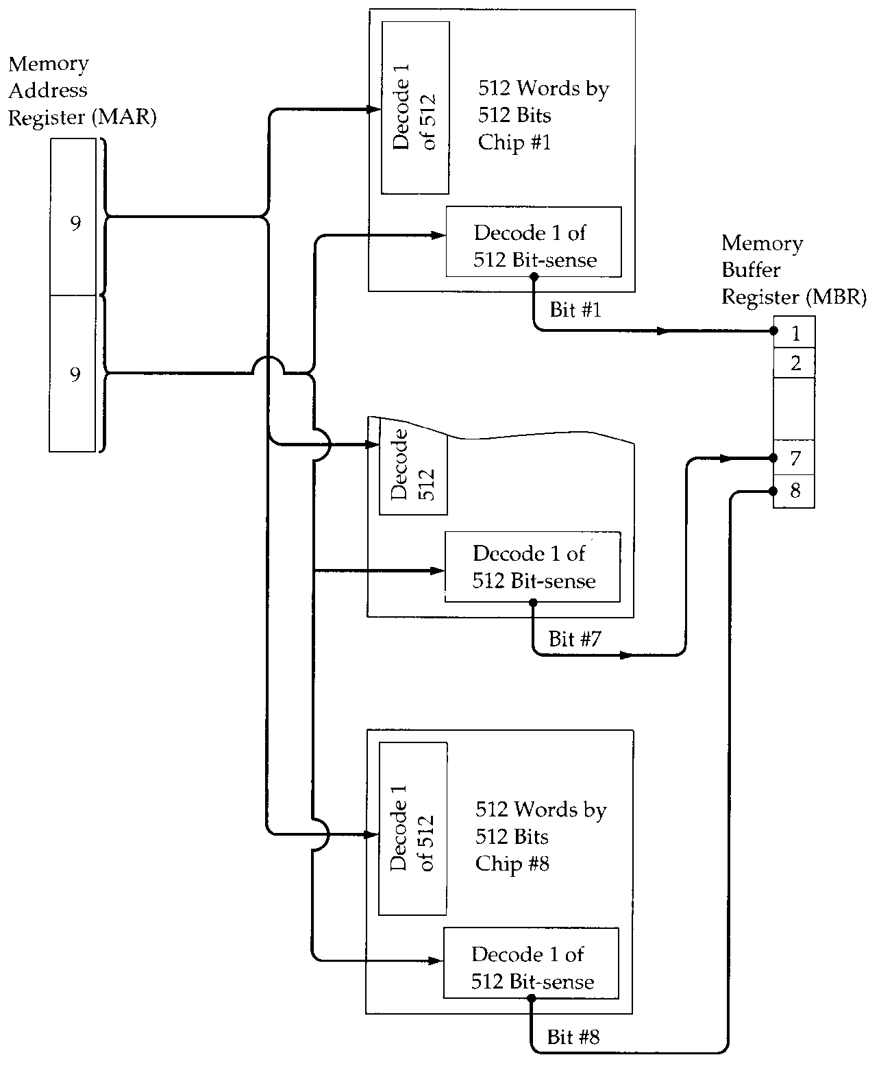
256kByte Module
Organisation

Slide 25
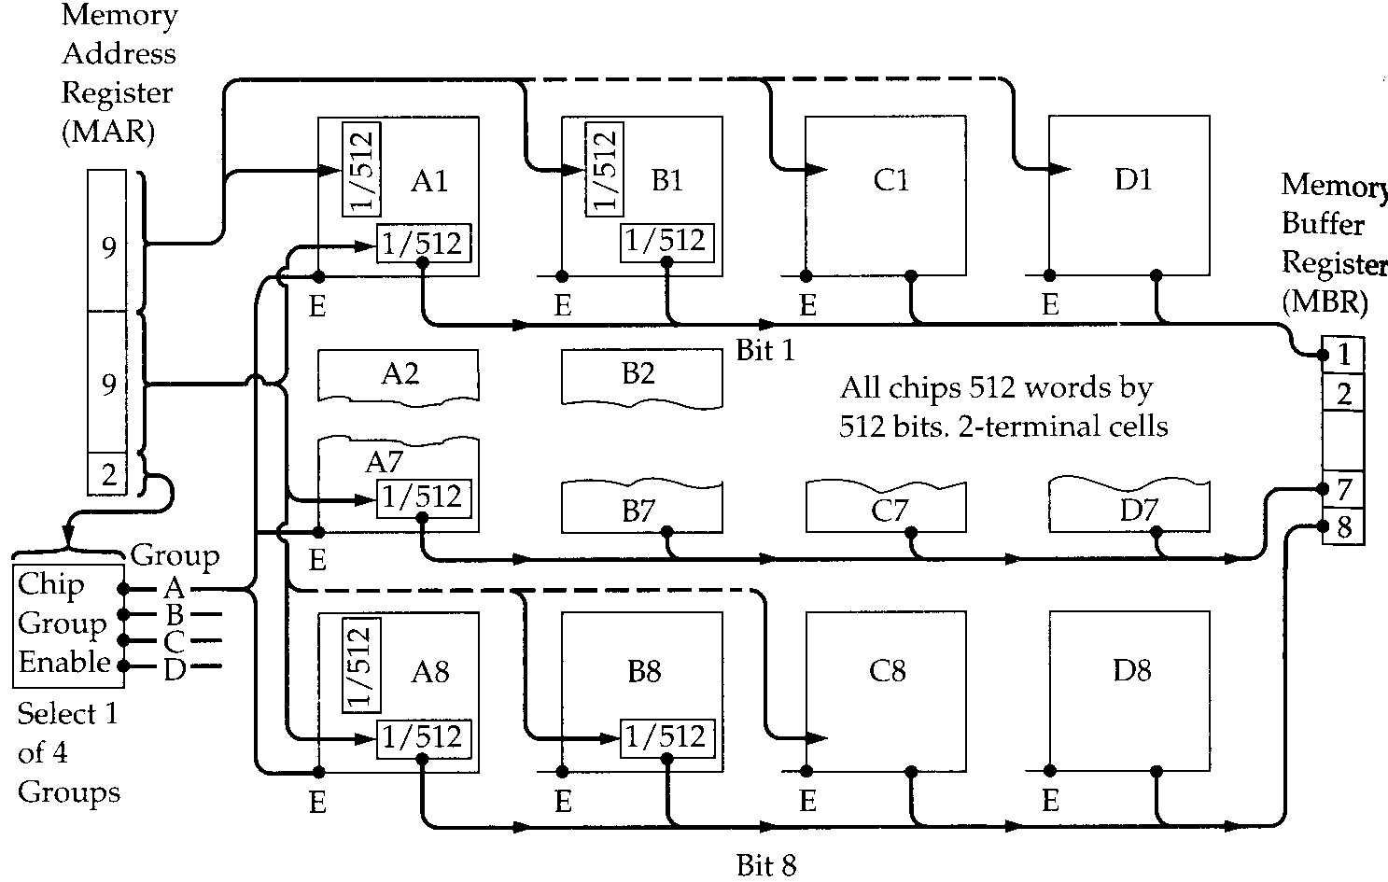
1MByte Module Organisation

Slide 26
Error Correction
Hard Failure
  Permanent defect
Soft Error
  Random, non-destructive
  No permanent damage to memory
Detected using Hamming error correcting code

Slide 27
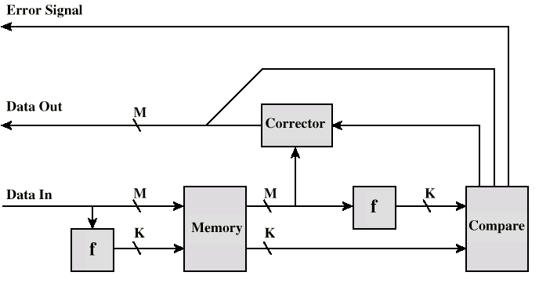
Error Correcting Code Function

Slide 28
Advanced DRAM Organization
Basic DRAM same since first RAM chips
Enhanced DRAM
  Contains small SRAM as well
  SRAM holds last line read (c.f. Cache!)
Cache DRAM
  Larger SRAM component
  Use as cache or serial buffer

Slide 29
Synchronous DRAM (SDRAM)
Access is synchronized with an external clock
Address is presented to RAM
RAM finds data (CPU waits in conventional DRAM)
Since SDRAM moves data in time with system clock, CPU knows when data will be ready
CPU does not have to wait, it can do something else
Burst mode allows SDRAM to set up stream of data and fire it out in block
DDR-SDRAM sends data twice per clock cycle (leading & trailing edge)

Slide 30
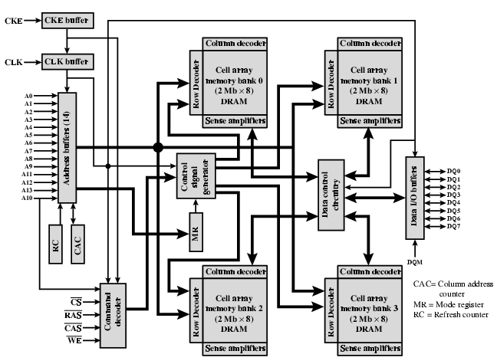
SDRAM

Slide 31
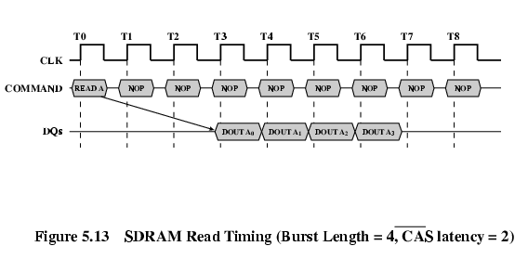
SDRAM Read Timing

Slide 32
RAMBUS
Adopted by Intel for Pentium & Itanium
Main competitor to SDRAM
Vertical package – all pins on one side
Data exchange over 28 wires < cm long
Bus addresses up to 320 RDRAM chips at 1.6Gbps
Asynchronous block protocol
  480ns access time
  Then 1.6 Gbps

Slide 33
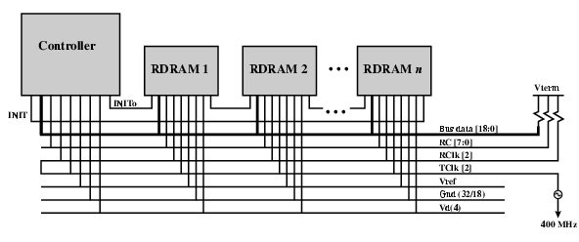
RAMBUS Diagram

Slide 34
DDR SDRAM
SDRAM can only send data once per clock
Double-data-rate SDRAM can send data twice per clock cycle
  Rising edge and falling edge

Slide 35
Cache DRAM
Mitsubishi
Integrates small SRAM cache (16 kb) onto generic DRAM chip
Used as true cache
  64-bit lines
  Effective for ordinary random access
To support serial access of block of data
  E.g. refresh bit-mapped screen
    CDRAM can prefetch data from DRAM into SRAM buffer
    Subsequent accesses solely to SRAM

Slide 36
Reading
The RAM Guide
RDRAM

